Slide 1

William Chen, Kyu Ho Sim, Chloe Ashdale

Slide 2
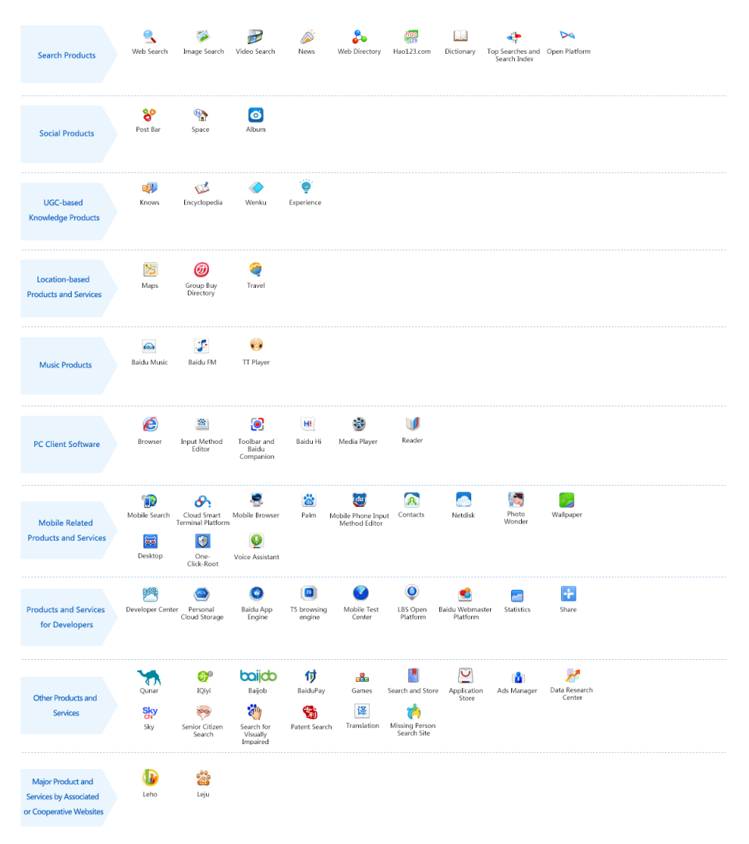
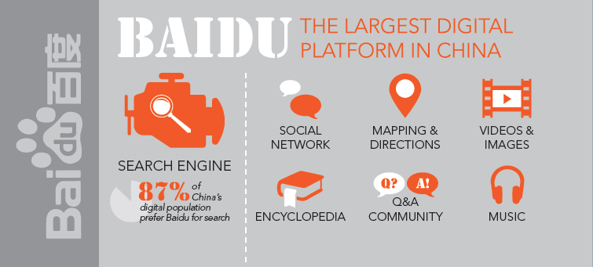
Baidu’s Background
Search engine like Google
“Chinese Google”
Founded on January 1, 2000
Headquartered in Beijing, China
Popular in China
94% of its users are in China
Offers services like Baidu Maps, Wangpan, News, “Knows”, MP3 Search, etc.

Slide 3
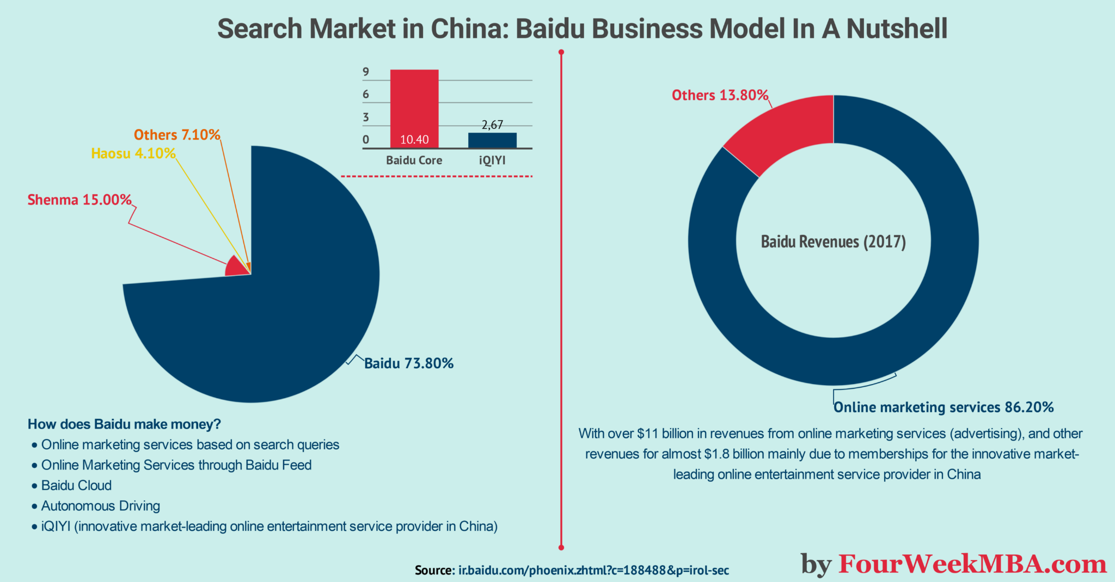
Baidu’s Business Model
Primary source of revenue is through advertisements
Made $11.24 billion on ads in 2017
2020 revenue: $16.4 billion
Secondary source is through services they offer like Iqiyi

Slide 4




Key Aspects of Platform-ness
Baidu Wangpan
Baidu Baike
Baidu Maps
Quanmin

Slide 5

Baidu VS US Platforms
Similarities
Search Engine
Multiple Offerings
Revenue come from advertisements
Differences
Censorship
Better understanding of Chinese local language and culture(Focus on local news)
Unique offerings
Revenue mainly comes from China

Slide 6
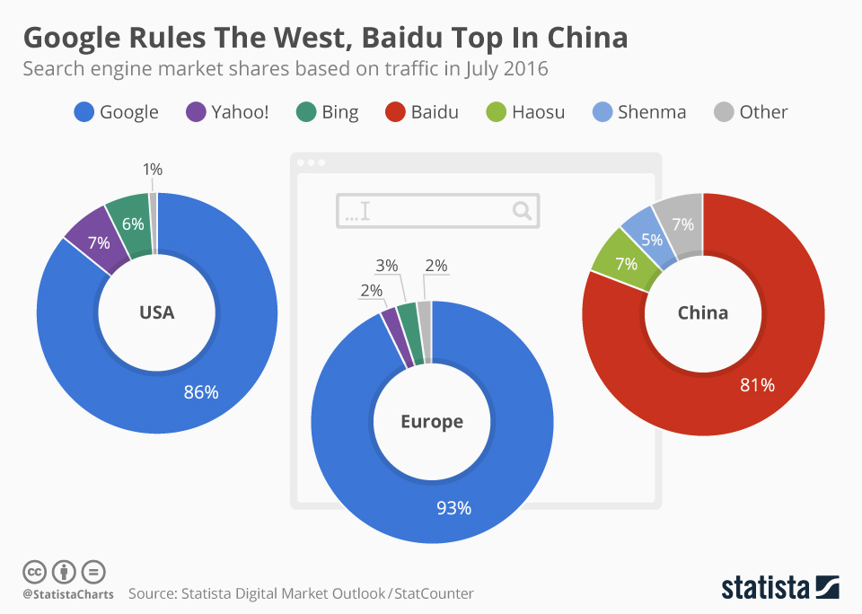

Slide 7
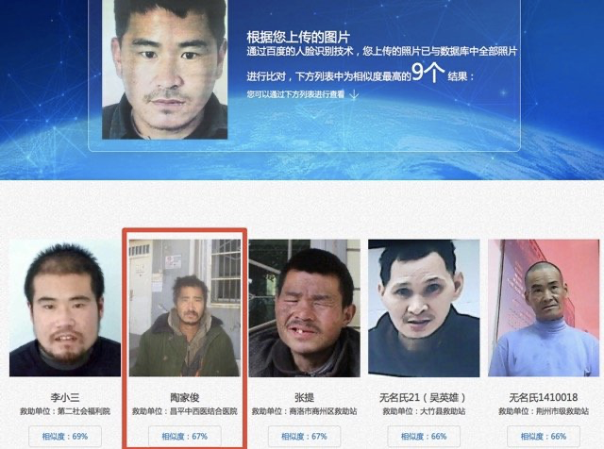
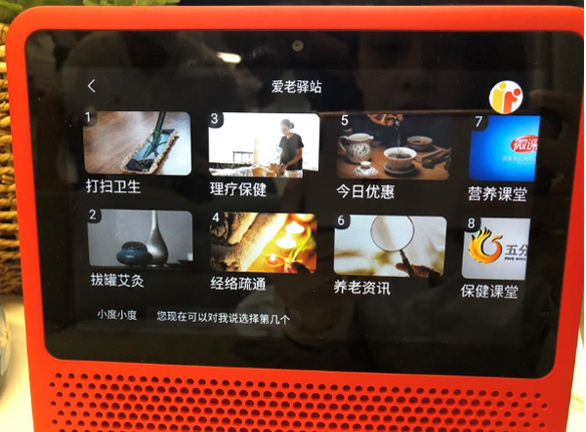
Does it have a strategic "moat"?
UNIQUE SERVICES
Baidu offers a platform that leverages face recognition technology to find missing persons.
Baidu started a service that provides useful things for senior people’s daily life.

Slide 8

Is it profitable?
Baidu generated 68% of its revenue from its online marketing services in the fourth quarter
Compared to 72% a year ago
Its revenue dipped 0.3% year over year to 20.71 billion yuan ($3.17 billion) during the quarter
Marks its seventh straight quarter of declining sales
Advertising is Baidu’s primary source of revenue

Slide 9
What else should we US folks know about it?
For comparison, Baidu ended the quarter with 544 million monthly active users on its mobile app
But WeChat's saw 1.21 billion
Baidu is also increasing its exposure to the live streaming market with its content creation platform BJH and its upcoming takeover of YY Live
Hosts roughly 70% of China’s internet searches
Although Baidu’s primary product is its search engine, the company provides platforms such as maps, images and videos, and news searches. The company has also launched a campaign of aggressive expansion into artificial intelligence (AI) and self-driving cars.

Slide 10
References
https://www.statista.com/statistics/257592/share-of-baidu-users-by-country/
https://ir.baidu.com/news-releases/news-release-details/baidu-announces-first-quarter-2019-results
https://www.searchenginejournal.com/baidu-facts/336803/#close
https://www.rankingbyseo.com/blog/baidu-seo/
https://ir.baidu.com/news-releases/news-release-details/baidu-announces-fourth-quarter-and-fiscal-year-2017-results
https://ir.baidu.com/static-files/60164d47-7103-4181-909c-57eea0355d83
https://ir.baidu.com/financial-reports
https://fourweekmba.com/baidu-business-model/#How_does_Baidu_make_money
https://en.wikipedia.org/wiki/Baidu#Services
https://www.fool.com/investing/2021/02/20/is-baidu-stock-a-buy/
https://www.statista.com/chart/5472/google-rules-the-west-baidu-top-in-china/

